Slide 1
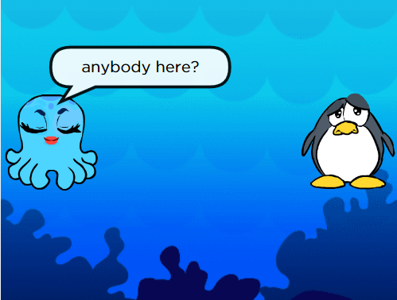
Stage 17: Play Lab: Create a Game

Slide 2
Objectives
Students will:
Identify actions that correlate to input events
Create an animated, interactive story using sequence, loops, and event-handlers
Share a creative artifact with other students

Slide 3
Video
https://studio.code.org/s/course3/stage/17/puzzle/1

Slide 4
Example
The octopus will respond to the click event by saying “hello”
Where do you put the code?

Slide 5
Directions
Complete Stage 17: Play Lab: Create a Game
Progress your way through the stage

